Slide 1
lms

Slide 2
import numpy as np
def lms_filter(input_signal, desired_signal, filter_order, learning_rate):
"""
Implements the Least Mean Squares (LMS) algorithm for noise reduction.
Parameters:
input_signal (array): The input signal contaminated with noise.
desired_signal (array): The desired signal (noise-free signal).
filter_order (int): The order of the LMS filter.
learning_rate (float): The step size or learning rate of the LMS algorithm.
Returns:
filtered_signal (array): The noise-reduced signal.
"""
num_samples = len(input_signal)
w = np.zeros(filter_order) # Initialize filter coefficients
filtered_signal = np.zeros(num_samples)
for i in range(num_samples - filter_order):
x = input_signal[i:i+filter_order] # Input vector
y = np.dot(w, x) # Filter output
e = desired_signal[i+filter_order] - y # Error signal
w = w + learning_rate * e * x # Update filter coefficients
filtered_signal[i+filter_order] = y
return filtered_signal

Slide 3
# Example usage:
# Generate a noisy signal
np.random.seed(0)
t = np.linspace(0, 1, 1000)
noise = 0.5 * np.random.randn(len(t))
input_signal = np.sin(2 * np.pi * 5 * t) + noise
# Create a desired signal (noise-free signal)
desired_signal = np.sin(2 * np.pi * 5 * t)
# Apply LMS filter to reduce noise
filter_order = 10
learning_rate = 0.01
filtered_signal = lms_filter(input_signal, desired_signal, filter_order, learning_rate)
# Plot results
import matplotlib.pyplot as plt
plt.figure(figsize=(10, 6))
plt.plot(t, input_signal, label='Noisy Signal')
plt.plot(t, desired_signal, label='Desired Signal')
plt.plot(t, filtered_signal, label='Filtered Signal (LMS)')
plt.xlabel('Time')
plt.ylabel('Amplitude')
plt.title('LMS Filter for Noise Reduction')
plt.legend()
plt.grid(True)
plt.show()

Slide 4
weiner

Slide 5
import numpy as np
import matplotlib.pyplot as plt
def wiener_filter(input_signal, desired_signal, filter_order):
"""
Implements the Wiener filter for noise reduction.
Parameters:
input_signal (array): The input signal contaminated with noise.
desired_signal (array): The desired signal (noise-free signal).
filter_order (int): The order of the Wiener filter.
Returns:
filtered_signal (array): The noise-reduced signal.
""" # Compute power spectral densities
P_signal = np.abs(np.fft.fft(desired_signal)) ** 2
P_noise = np.abs(np.fft.fft(input_signal - desired_signal)) ** 2
# Compute Wiener filter transfer function
H = np.conj(P_signal) / (np.conj(P_signal) + P_noise)
# Apply Wiener filter in frequency domain
F_input_signal = np.fft.fft(input_signal)
F_filtered_signal = H * F_input_signal
# Convert back to time domain
filtered_signal = np.real(np.fft.ifft(F_filtered_signal))
return filtered_signal

Slide 6
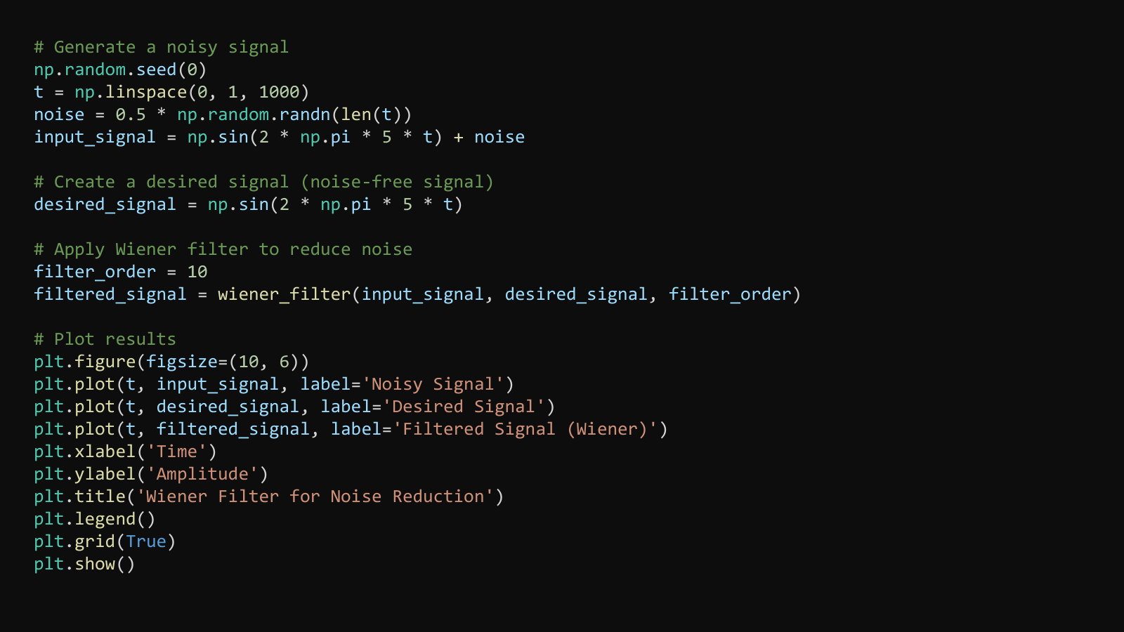

Slide 7
NN

Slide 8
import numpy as np
import tensorflow as tf
import matplotlib.pyplot as plt
from sklearn.model_selection import train_test_split
# Generate data
np.random.seed(0)
t = np.linspace(0, 1, 1000)
noise = 0.5 * np.random.randn(len(t))
clean_signal = np.sin(2 * np.pi * 5 * t)
noisy_signal = clean_signal + noise
# Create training data
X = noisy_signal.reshape(-1, 1)
y = clean_signal.reshape(-1, 1)
# Split data into training and validation sets
X_train, X_val, y_train, y_val = train_test_split(X, y, test_size=0.2, random_state=42)
# Define neural network model
model = tf.keras.Sequential([
tf.keras.layers.Dense(128, activation='relu', input_shape=(1,)),
tf.keras.layers.Dense(128, activation='relu'),
tf.keras.layers.Dense(128, activation='relu'),
tf.keras.layers.Dense(1)
])

Slide 9
# Compile model
model.compile(optimizer='adam', loss='mse')
# Train model
history = model.fit(X_train, y_train, validation_data=(X_val, y_val), epochs=50, batch_size=32)
# Plot training history
plt.plot(history.history['loss'], label='Training Loss')
plt.plot(history.history['val_loss'], label='Validation Loss')
plt.xlabel('Epochs')
plt.ylabel('Loss')
plt.title('Training History')
plt.legend()
plt.show()
# Perform noise reduction on test data
cleaned_signal = model.predict(X)

Slide 10
# Plot results
plt.figure(figsize=(10, 6))
plt.plot(t, noisy_signal, label='Noisy Signal')
plt.plot(t, clean_signal, label='Clean Signal')
plt.plot(t, cleaned_signal, label='Cleaned Signal (Neural Network)')
plt.xlabel('Time')
plt.ylabel('Amplitude')
plt.title('Noise Reduction using Neural Network')
plt.legend()
plt.grid(True)
plt.show()

Slide 11
NN and weiner

Slide 12
import numpy as np
import tensorflow as tf
import matplotlib.pyplot as plt
from sklearn.model_selection import train_test_split
def wiener_filter(input_signal, desired_signal, filter_order):
"""
Implements the Wiener filter for noise reduction.
Parameters:
input_signal (array): The input signal contaminated with noise.
desired_signal (array): The desired signal (noise-free signal).
filter_order (int): The order of the Wiener filter.
Returns:
filtered_signal (array): The noise-reduced signal.
"""
# Compute power spectral densities
P_signal = np.abs(np.fft.fft(desired_signal)) ** 2
P_noise = np.abs(np.fft.fft(input_signal - desired_signal)) ** 2
# Compute Wiener filter transfer function
H = np.conj(P_signal) / (np.conj(P_signal) + P_noise)
# Apply Wiener filter in frequency domain
F_input_signal = np.fft.fft(input_signal)
F_filtered_signal = H * F_input_signal

Slide 13
# Convert back to time domain
filtered_signal = np.real(np.fft.ifft(F_filtered_signal))
return filtered_signal
# Generate a noisy signal
np.random.seed(0)
t = np.linspace(0, 1, 1000)
noise = 0.5 * np.random.randn(len(t))
input_signal = np.sin(2 * np.pi * 5 * t) + noise
# Create a desired signal (noise-free signal)
desired_signal = np.sin(2 * np.pi * 5 * t)
# Apply Wiener filter to reduce noise
filter_order = 10
filtered_signal_wiener = wiener_filter(input_signal, desired_signal, filter_order)
# Generate data
noisy_signal = filtered_signal_wiener # Input to neural network is the Wiener filtered signal
# Create training data
X = noisy_signal.reshape(-1, 1)
y = desired_signal.reshape(-1, 1) # Using desired_signal as clean signal

Slide 14
# Split data into training and validation sets
X_train, X_val, y_train, y_val = train_test_split(X, y, test_size=0.2, random_state=42)
# Define neural network model
model = tf.keras.Sequential([
tf.keras.layers.Dense(128, activation='relu', input_shape=(1,)),
tf.keras.layers.Dense(128, activation='relu'),
tf.keras.layers.Dense(128, activation='relu'),
tf.keras.layers.Dense(1)
])
# Compile model
model.compile(optimizer='adam', loss='mse')
# Train model
history = model.fit(X_train, y_train, validation_data=(X_val, y_val), epochs=50, batch_size=32)
# Plot training history
plt.plot(history.history['loss'], label='Training Loss')
plt.plot(history.history['val_loss'], label='Validation Loss')
plt.xlabel('Epochs')
plt.ylabel('Loss')
plt.title('Training History')
plt.legend()
plt.show()

Slide 15
# Perform noise reduction on test data
cleaned_signal_neural_network = model.predict(X)
# Plot results
plt.figure(figsize=(10, 6))
plt.plot(t, input_signal, label='Noisy Signal')
plt.plot(t, desired_signal, label='Desired Signal')
plt.plot(t, filtered_signal_wiener, label='Filtered Signal (Wiener)')
plt.plot(t, cleaned_signal_neural_network, label='Cleaned Signal (Neural Network)')
plt.xlabel('Time')
plt.ylabel('Amplitude')
plt.title('Noise Reduction using Wiener Filter and Neural Network')
plt.legend()
plt.grid(True)
plt.show()

Slide 16
DNN

Slide 17
import numpy as np
import tensorflow as tf
import matplotlib.pyplot as plt
from sklearn.model_selection import train_test_split
# Generate data
np.random.seed(0)
t = np.linspace(0, 1, 1000)
noise = 0.5 * np.random.randn(len(t))
clean_signal = np.sin(2 * np.pi * 5 * t)
noisy_signal = clean_signal + noise
# Create training data
X = noisy_signal.reshape(-1, 1)
y = clean_signal.reshape(-1, 1)
# Split data into training and validation sets
X_train, X_val, y_train, y_val = train_test_split(X, y, test_size=0.25, random_state=42)
# Define deep neural network model
model = tf.keras.Sequential([
tf.keras.layers.Dense(128, activation='relu', input_shape=(1,)),
tf.keras.layers.Dense(256, activation='relu'), # Added a hidden layer with 256 neurons
tf.keras.layers.Dense(256, activation='relu'), # Added another hidden layer with 256 neurons
tf.keras.layers.Dense(128, activation='relu'), # Another hidden layer with 128 neurons
tf.keras.layers.Dense(1)
])

Slide 18
# Custom loss function using hidden variable
def custom_loss(y_true, y_pred):
hidden_variable = 0.09999 # Adjust as needed
error = tf.square(y_true - y_pred)
return tf.reduce_mean(error - hidden_variable)
# Compile model with custom loss
model.compile(optimizer='adam', loss=custom_loss)
# Train model
history = model.fit(X_train, y_train, validation_data=(X_val, y_val), epochs=50, batch_size=32)
# Plot training history
plt.plot(history.history['loss'], label='Training Loss')
plt.plot(history.history['val_loss'], label='Validation Loss')
plt.xlabel('Epochs')
plt.ylabel('Loss')
plt.title('Training History')
plt.legend()
plt.show()
# Perform noise reduction on test data
cleaned_signal = model.predict(X)

Slide 19
# Plot results
plt.figure(figsize=(10, 6))
plt.plot(t, noisy_signal, label='Noisy Signal')
plt.plot(t, clean_signal, label='Clean Signal')
plt.plot(t, cleaned_signal, label='Cleaned Signal (Deep Neural Network)')
plt.xlabel('Time')
plt.ylabel('Amplitude')
plt.title('Noise Reduction using Deep Neural Network')
plt.legend()
plt.grid(True)
plt.show()

